Slide 1
React
Components - Props - States
Mahhek Tahir
Notes:
.

Slide 2
React Components
Reusable, independent UI pieces
Can be Class Components or Function Components
Components can have state and props
Components help in modularizing code

Slide 3
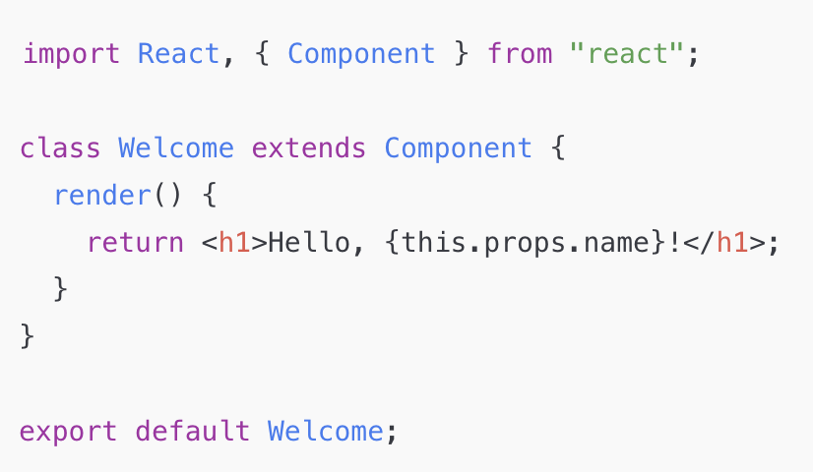
Class Components
Older way of writing React components
Uses class keyword and extends React.Component
Must have a render() method

Slide 4
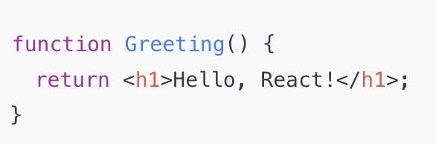
Function Components
JavaScript functions that return JSX
Simpler than class components

Slide 5
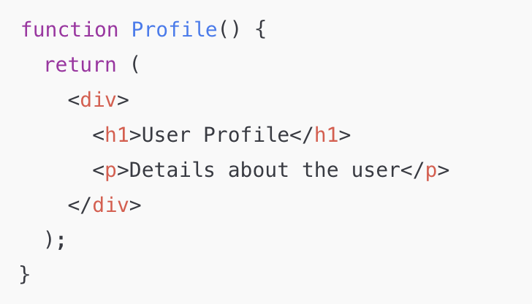
Nested JSX in Functional Components
JSX can have multiple elements inside a div

Slide 6
What are props?
Short for "Properties"
Passed from Parent to Child
Read-only (Immutable)

Slide 7
Passing Props
Parent Component (App.js)
function App() {
return <Greeting name="John" />;
}
Child Component (Greeting.js)
function Greeting(props) {
return <h1>Hello, {props.name}!</h1>;
}
name is passed as a prop

Slide 8
Default prop value
function Greeting({ name = "Guest" })
{
return <h1>Hello, {name}!</h1>;
}
If name is not provided, it defaults to "Guest"

Slide 9
Multiple props
Parent Component (App.js)
function App() {
return <UserInfo name="John Doe" age={25} city="New York" />;
}
Child Component (UserInfo.js)
function UserInfo(props) {
return (
<div>
<h1>Name: {props.name}</h1>
<h2>Age: {props.age}</h2>
<h3>City: {props.city}</h3>
</div>
);
}
export default UserInfo;
🔹 Here, we pass three props (name, age, city) to UserInfo.

Slide 10
Destructuring
Instead of writing props.name, props.age, etc., we can destructure props:
Child Component (UserInfo.js)
function UserInfo({ name, age, city }) {
return (
<div>
<h1>Name: {name}</h1>
<h2>Age: {age}</h2>
<h3>City: {city}</h3>
</div>
);
}
export default UserInfo;
🔹 Easy to read

Slide 11
Passing Objects as Props
Parent Component (App.js)
const user = { name: "John Doe", age: 25, city: "New York" };
function App() {
return <UserInfo user={user} />;
}
Child Component (UserInfo.js)
function UserInfo({ user }) {
return (
<div>
<h1>Name: {user.name}</h1>
<h2>Age: {user.age}</h2>
<h3>City: {user.city}</h3>
</div>
);
} Instead of passing multiple props, we pass a single object (user) and access its properties inside the child component.

Slide 12
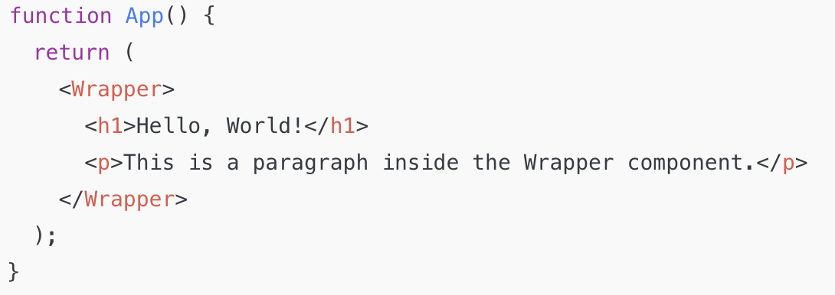
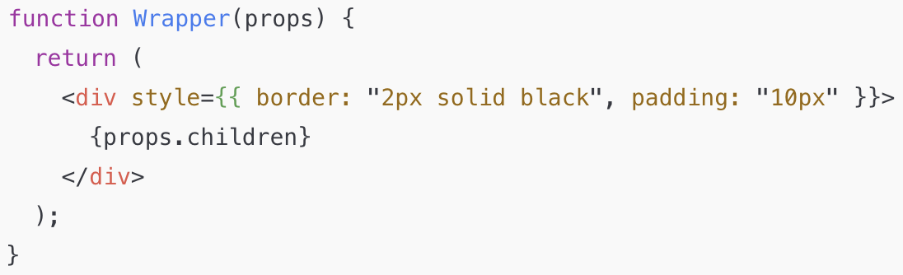
What is props.children?
props.children is a special prop in React that allows components to wrap other components or elements inside them.
It is useful when creating reusable wrapper components like cards, modals, layouts, etc.

Slide 13
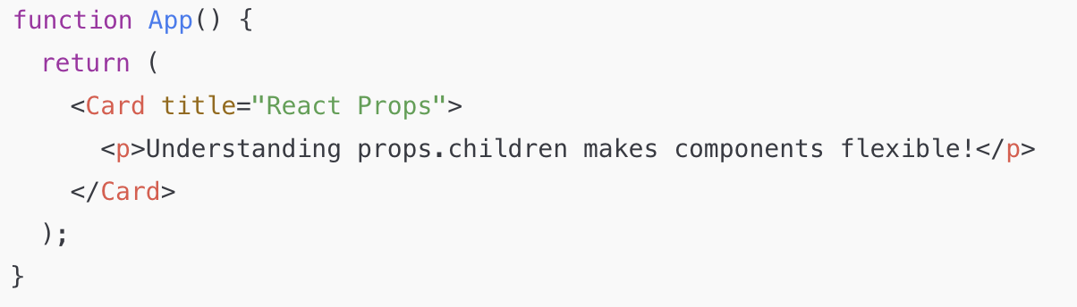
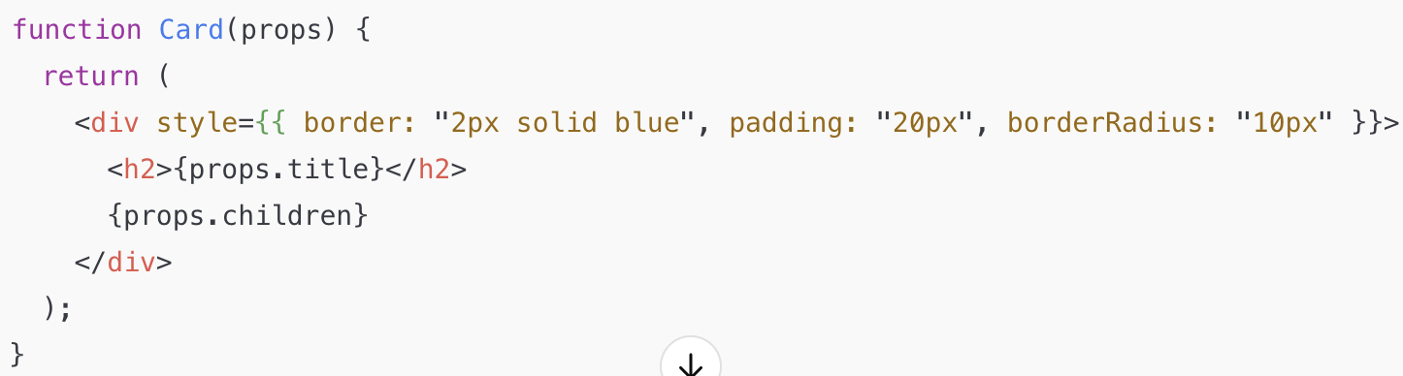
Another example
Notes:
Example: Single java jar file

Slide 14
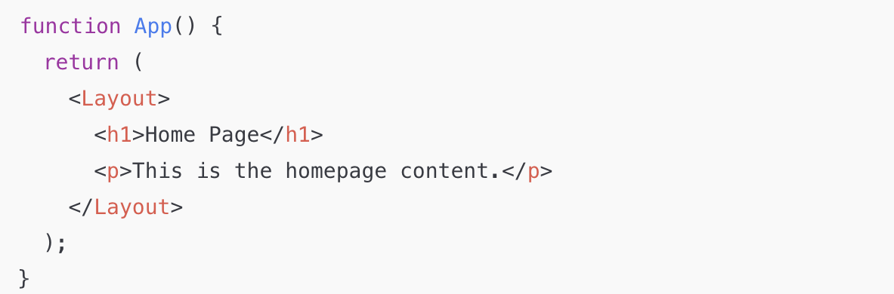
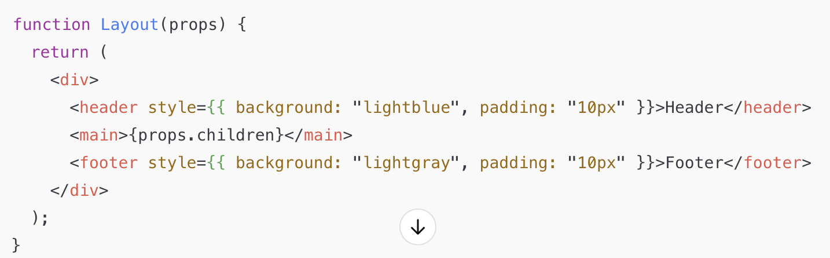
Layout Example
Notes:
Can you use API with monolith?

Slide 15
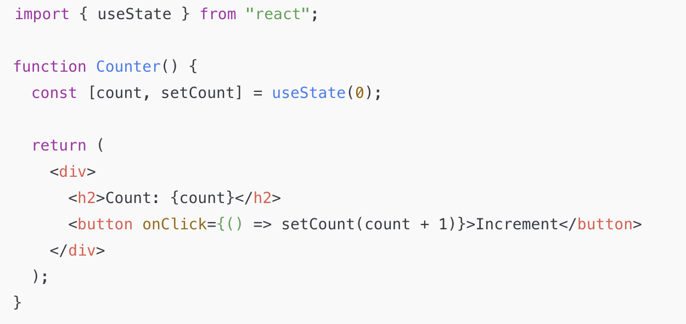
States in React
State stores dynamic data
Allows components to re-render
useState is used to manage state in functional components
Yes, <h2>Count: {count}</h2> automatically updates
The useState(0) creates a state variable called count.
Clicking the button updates the state using setCount().

Slide 16
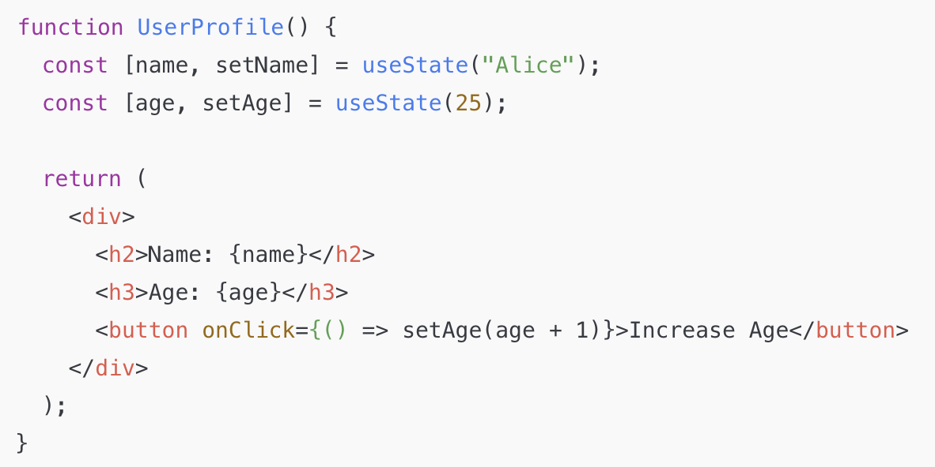
Multiple States
Clicking the button only updates age, keeping name unchanged.

Slide 17
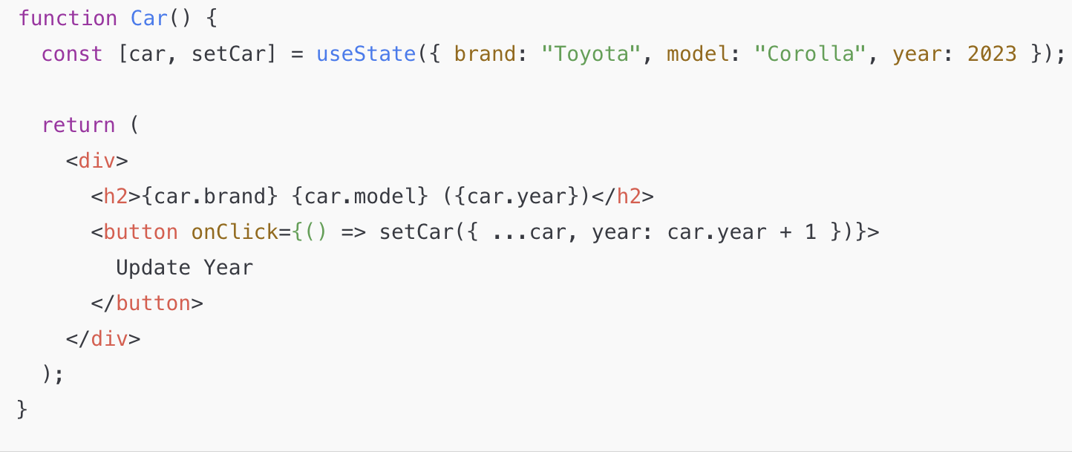
Object in States
The spread operator (...car) ensures other properties remain unchanged.

Slide 18
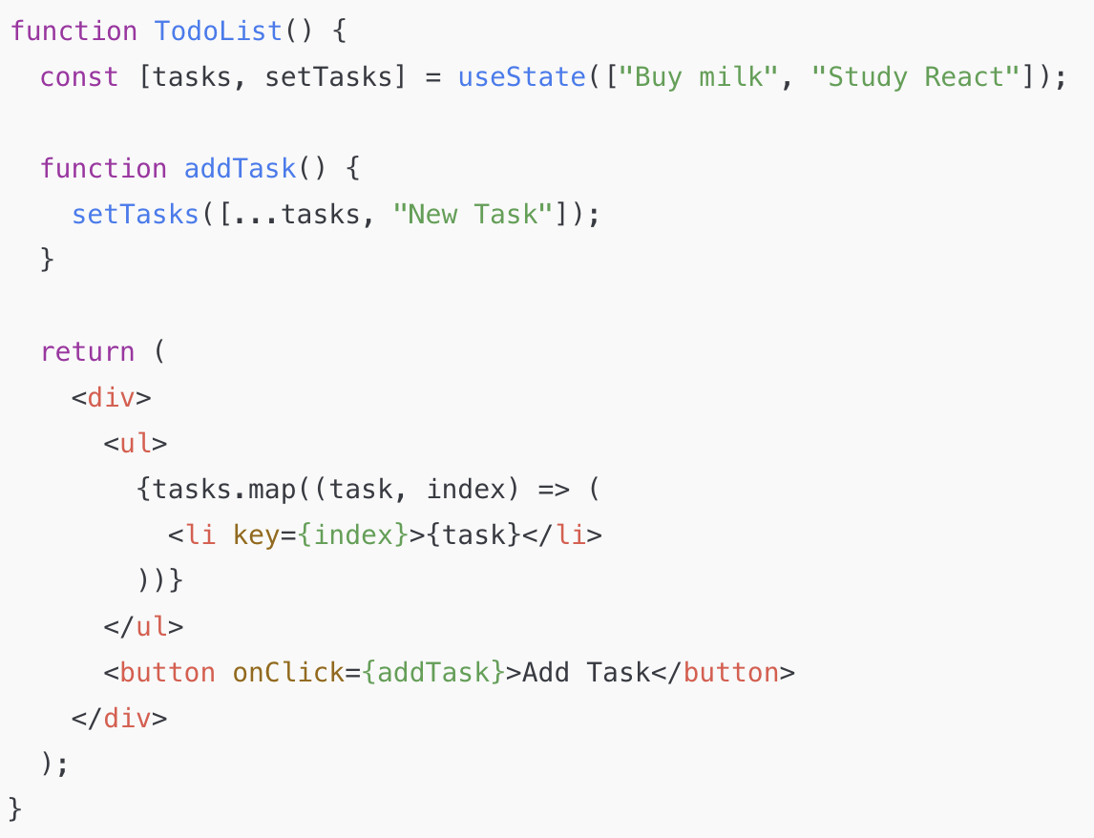
Arrays in States
The spread operator (...tasks) ensures we keep existing items when adding a new one.

Slide 19
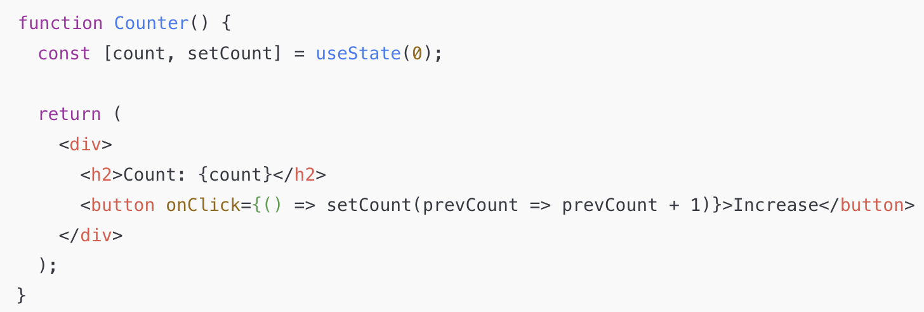
Updating States based on Previous
If state depends on the previous value, use a function inside setState().
Ensures correct updates when React batches multiple state updates.
Useful in asynchronous updates.

Slide 20
Why?
const [count, setCount] = useState(0);
return (
<div>
<h2>Count: {count}</h2>
<button onClick={() => {
setCount(prevCount => prevCount + 1);
setCount(prevCount => prevCount + 1);
setCount(prevCount => prevCount + 1);
}}>
Increase 3 times
</button>
</div>
);
}
Now, count correctly increases by 3 instead of just 1.
React batches state updates for performance reasons. If multiple updates happen at the same time, using setCount(count + 1) might not give the correct result.
<button onClick={() => {
setCount(count + 1);
setCount(count + 1);
setCount(count + 1);
}}>
Increase 3 times
</button>
Count only increases by 1 instead of by 3!

Slide 21
Conditional rendering
function UserGreeting(props) {
return (
<h2>{props.isLoggedIn ? "Welcome Back!" : "Please Log In"}</h2>
);
}

Slide 22
&& Conditional rendering
function Notification(props) {
return (
<div>
<h2>Notifications</h2>
{props.hasMessages && <p>You have new messages!</p>}
</div>
);
}

